Slide 1
Scene Analysis & Reconstruction Based on Geometric Distances
Zishuo Zhao
Advisor: Prof. Shi-Min Hu
Notes:
Good afternoon, everyone. The topic of my thesis is Scene Analysis and Reconstruction Based on Geometric Distances. It’s honored of me to do research under the guidance of Professor Hu, as well as to present my graduation work here.

Slide 2
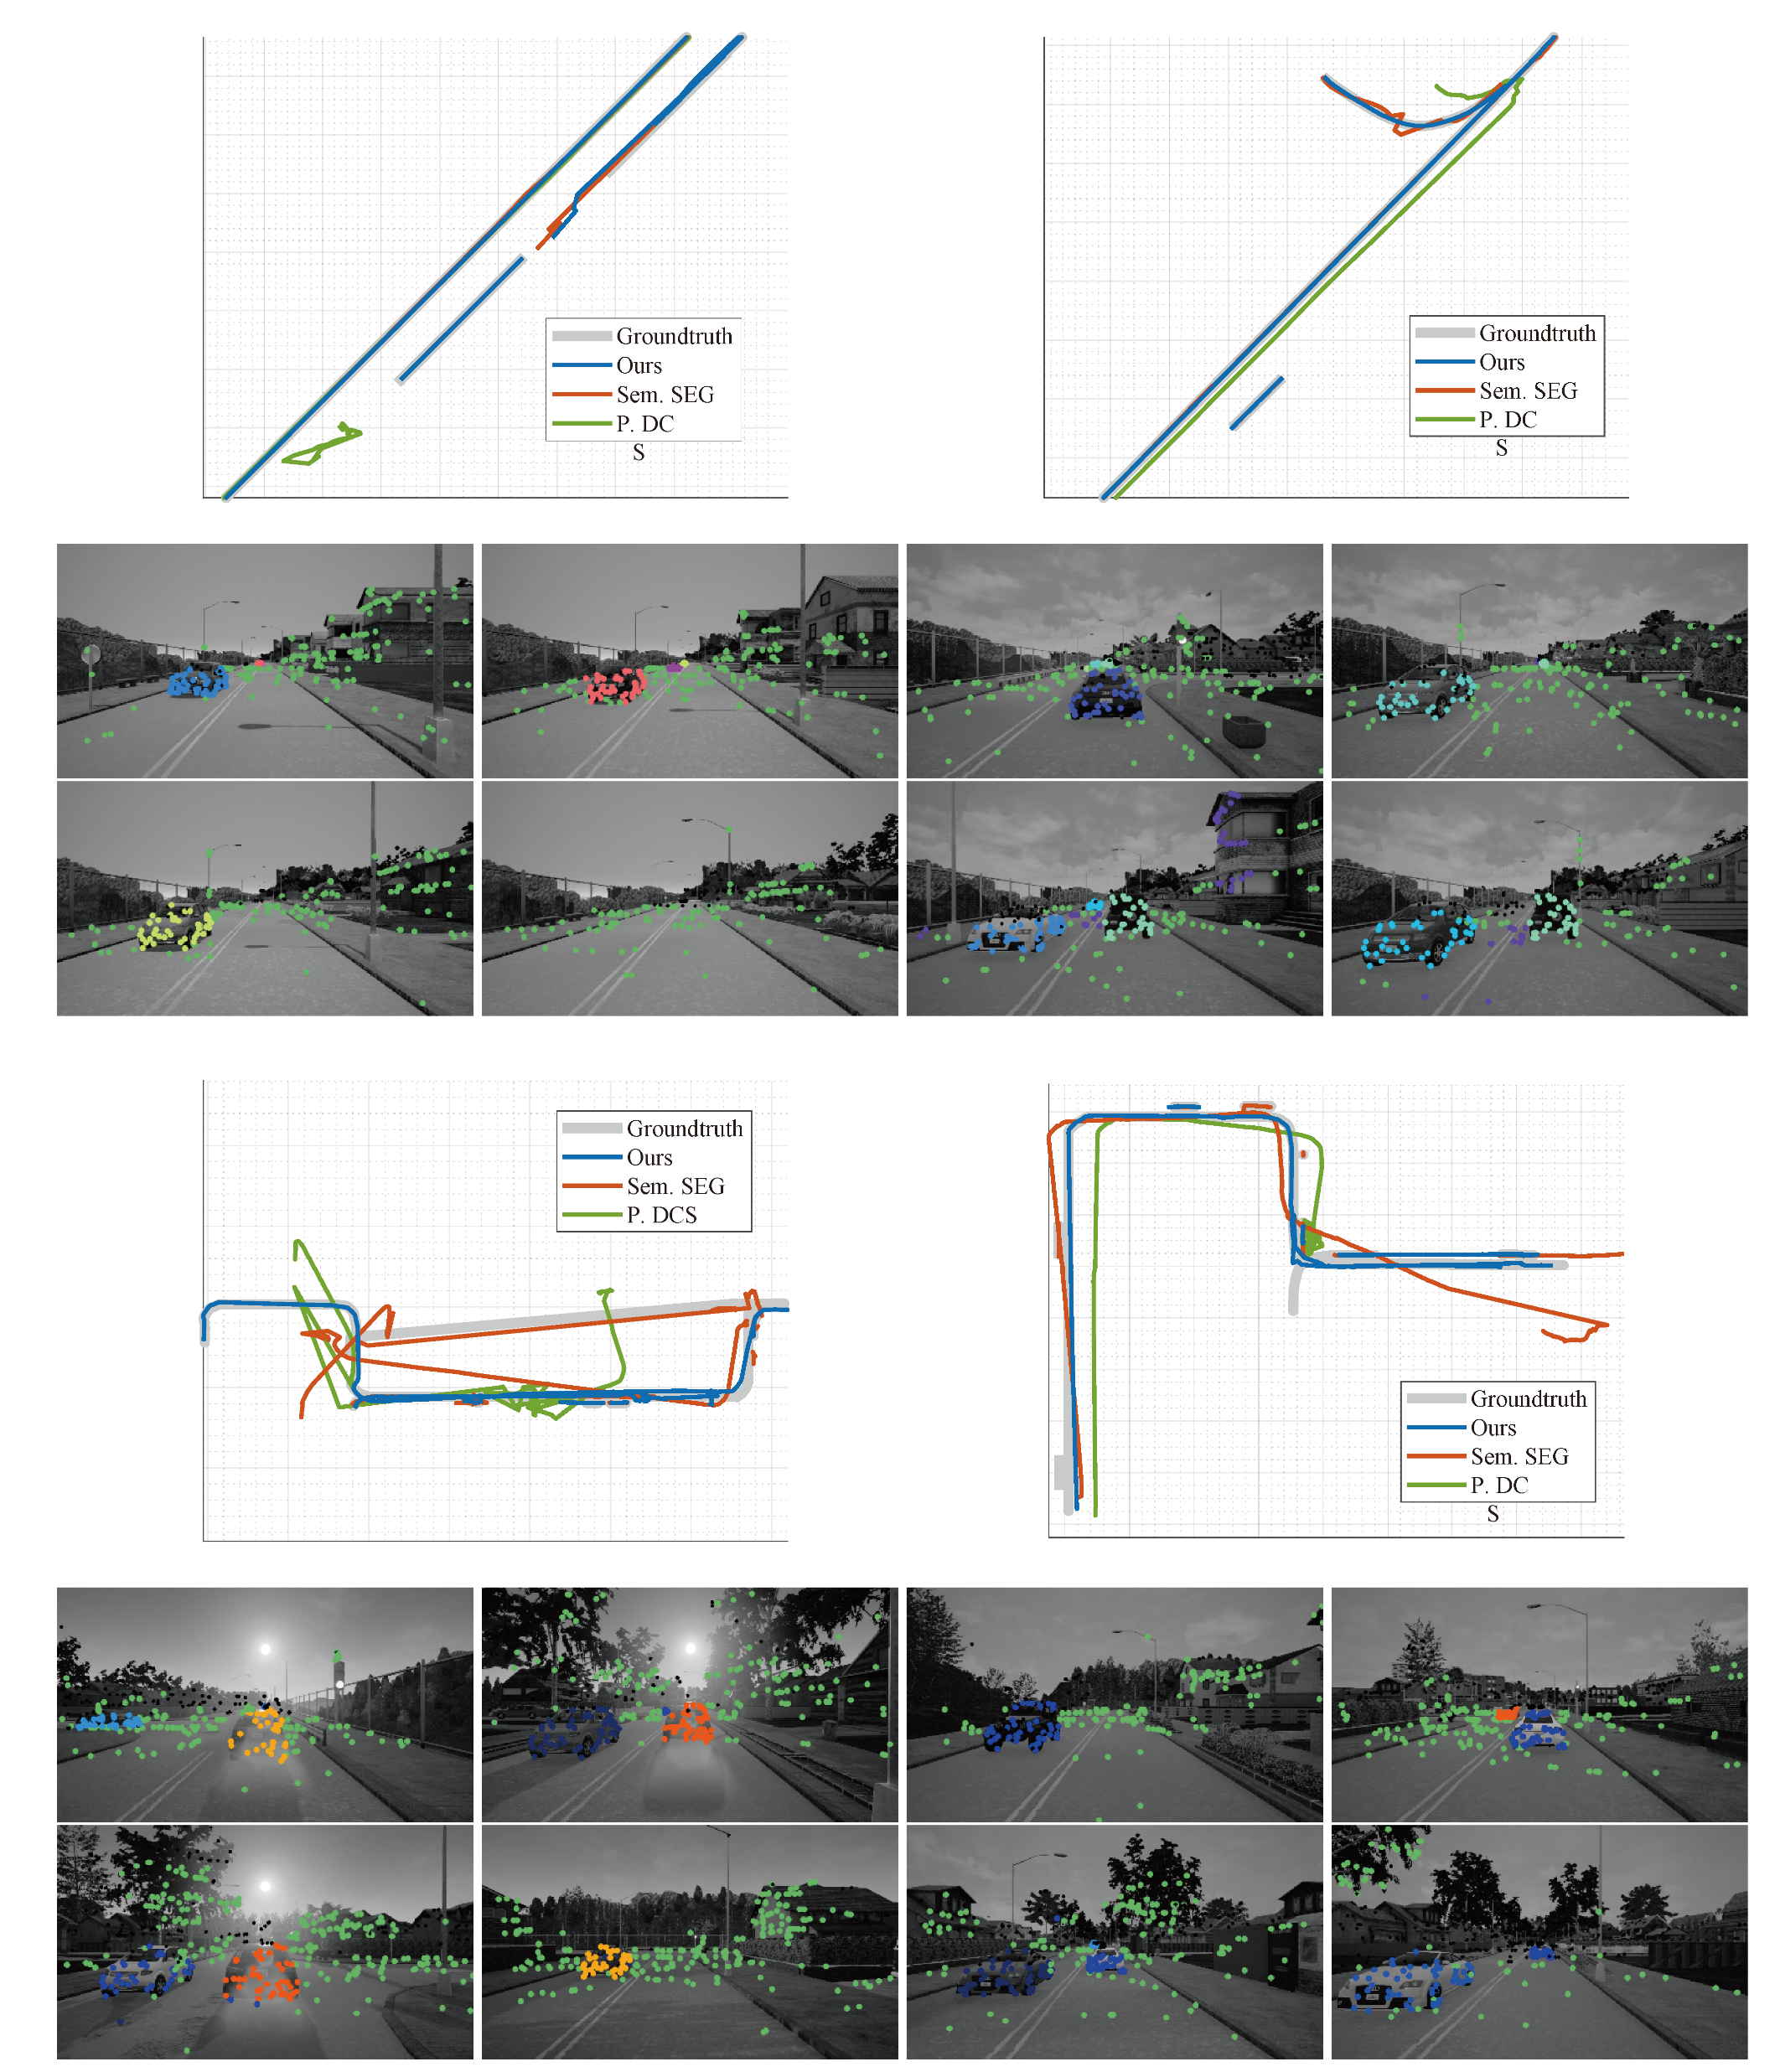
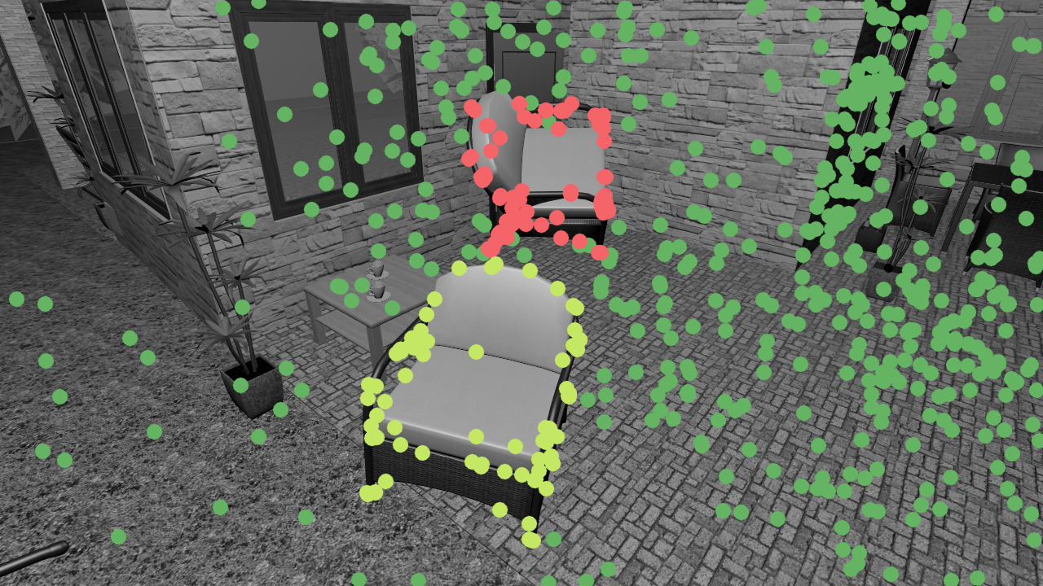
Background: ClusterSLAM (Our previous work, ICCV in review)
Clustering from variance of pointwise distances
Accuracy(indoor): 69.60% → 91.54%
Notes:
In the prior work ClusterSLAM last semester, we used a clustering algorithm based on pointwise motion consistency matrix, whose elements are determined by the variation of their geometric distances. Its success to improve the state-of-the-art accuracy by more than twenty percent shows the value of geometry in computer vision problems.

Slide 3
Main topic of my thesis
Reconstruct point cloud structures from (full/partial) noisy distance information
Find min-cost sets of distance constraints sufficient for recovery
Notes:
In our thesis, we focus on reconstruction of point cloud structures based on geometric distances, and finding a min-cost set of distance constraints which is sufficient for the recovery.

Slide 4
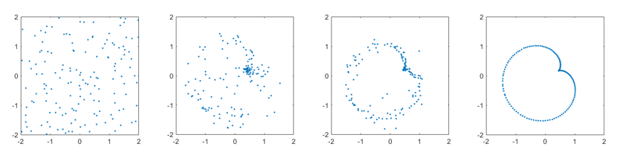
Euclidean Embedding (MDS)
Reconstruct spatial structure from Euclidean distances
The input can be noisy, partial, corrupted(not discussed here)
Notes:
MDS
The family of MDS algorithms is about reconstructing the spatial structure of an underlying point set from constraints of pairwise distances which can be noisy and partial, and we try to embed points in an Euclidean space with their pairwise distances as close as possible to the input, which is widely used in the field of data analysis.

Slide 5
Geometry-Stable MDS
Ground truth: P_{k◊n}, Distance observations: D Recovery: K_{k◊n},
If for n big enough, w.h.p. exists rigid transformation S s.t. ||K-SP||_{F} ≤ εn^{1/2} Then call it geometrically stable (Dividing LHS by n^{1/2} yields the rms of pointwise position errors)
Notes:
Here, we defined Geometrical Stability as a novel specification of an MDS algorithm for geometric reconstruction. For the underlying point cloud P and noisy distance observations D, and the reconstructed point cloud denoted as K, we call an MDS algorithm geometrically stable if for big n and with high probability, there exists a rigid transformation S to make K approximately equal to SP in the Frobinius norm.

Slide 6
Common MDS(cMDS)
Let D_{ij} = d_{ij}², H=I_{n}-1_{n◊n}/n, getting Grammian G=-HDH/2
Do eigen decomposition (Λ,U): U^{T}ΛU = G
Then K=Λ^{1/2}U is the result.
D
G
K
Distances
Grammian
Point Cloud
Notes:
The classical cMDS algorithm can recover the point cloud structure with accurate and full observation. In this algorithm, we firstly compute the Grammian matrix G from the squared distance matrix D, then do eigen decomposition on G and get the coordinate matrix K.

Slide 7
Geometrical Stability of cMDS
D
G=-HDH/2
G
K
(easy)
?
Notes:
In our thesis, we have proven the geometrical stability of cMDS in generic settings. The stability of cMDS is about the numerical stability from D to G to K. Stability from D to G is trivial, and the bottleneck is from G to K.

Slide 8

Geometrical Stability of cMDS: Proof
D
G
K
||ΔG|| = O(n^{1/2}) λ_{i}-λ_{i+1} = Θ(n)
Implying stability of Λ and U.
Stability of K.
eigen
(easy)
(Λ,U)
${\left\|K−SP\right\|}_{F}≤\left(1+o\left(1\right)\right)CD\sqrt{\frac{1}{4j\left(P\right)}+\frac{8h\left(P\right)}{g^{2}\left(P\right)}}, a.a.s.$ (Our work)
Notes:
The key point of our proof is on the eigen decomposition. Firstly we derive that for a fixed-scale noise model, the 2-norm of perturbation in G is in the order of sqroot n, and the spectral gap of G is in the order of n, so for big n, the 2-norm of perturbation is small compared to the spectral gap. From this, the perturbations of eigenvalues and eigenvectors are bounded, so is the perturbation of K, implying the geometrical stability of cMDS.

Slide 9
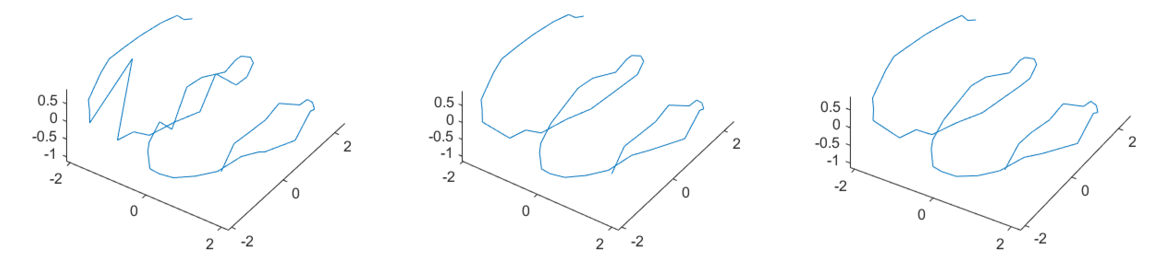
Sparse MDS & SDP experiments
Erdos-Renyi model: Ω(n log n) random edges for connectivity as a theoretical lower bound of MDS on random graphs!
Weak-MDS: exclude “unreliable” points and only recover the d-core. Only needs Ω(n) edges.
Raw SDP
Weak-MDS I
Weak-MDS II
Parameters: n=50, p=0.22, d=6, |core|=46
Notes:
We also explored doing MDS on random sparse distance graphs by semidefinite programming. By connectivity of Erdos-Renyi random graphs, we have a theoretical lower bound of Omega(n log n) edges. But if we can exclude some “unreliable” points and recover the majority, the bound can be lowered to Omega(n). We have done some experiments in both 2D and 3D for those. Although we haven’t got a guarantee in theory, they work.

Slide 10
Design of Geometrically Stable Graph
Proven: complete graphs are stable. (but redundant)
Goal: minimize the cost of graph. (#edges, total length)
#edges: computational cost
Total length: sensor network cost
Notes:
Now we consider design of sparse geometrically graphs on given points. We’ve already proven that complete graphs are geometrically stable, but we are also interested in minimum graphs, to minimize the cost while keeping the property.

Slide 11
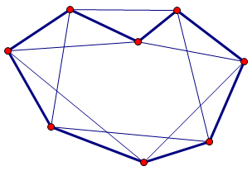
Existing work: minimum global rigid graphs
Global rigidity: Unique structure satisfying given edge lengths.
Minimum #edges: Θ(kn)
Algorithm: find a approx. minimum Hamiltonian cycle, connect points with graph-theory distance ≤k.
Problem: all edges are “local”. Cumulative error for global reconstruction!
Notes:
A necessary condition is global rigidity, which means that when the edge lengths are accurately constrained, there is only one equivalent structure to satisfy that. Existing results show the minimum number of edges is Theta(kn) for k dimensions, and there has been an algorithm to compute the approximate min-cost global rigid spanning graphs.
However, because all edges are local, cumulative errors will make the geometry unstable. Imagine that n is large, then it may take many edges from one point to another, and their error will accumulate.

Slide 12
Anchor-Point Scheme: Motivation
Global edges: stability but high-cost
Local edges: low-cost
Could we combine them?
Notes:
Intuitively, we need some global edges to make the graph stable, but too many of them will raise the cost. How can we combine global and local edges to lower the cost while keep the stability?

Slide 13
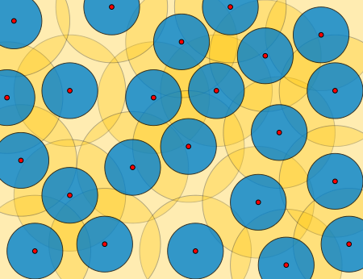

Anchor-Point Scheme: ε-net
Choose evenly distributed anchor points R by furthest sampling
ε-net: ε-sparse ε-cover of a point set
$ε≤\frac{2Diam(P)}{\sqrt[k]{\left|R\right|}−1}$ by volumetric argument
Notes:
We try it in another way. We already have geometrical stability of complete graphs, so we can choose some anchor points with even distribution by farthest sampling as an epsilon-net of the point cloud, and the epsilon can be bounded by means of the volume. Then we fully connect them.

Slide 14
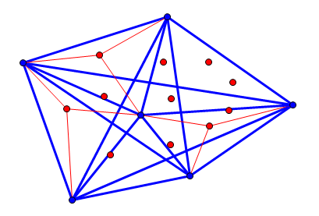
Anchor-Point Scheme: Hierarchical Connection
Connect all pairs of anchor points with global edges.
Connect other points to k+1 nearby anchors each with local edges.
Notes:
For other points, we only connect each to k+1 nearby anchor points, forming into a hierarchical graph. This graph can be proven to be globally rigid, and we discuss its geometrical stability.

Slide 15
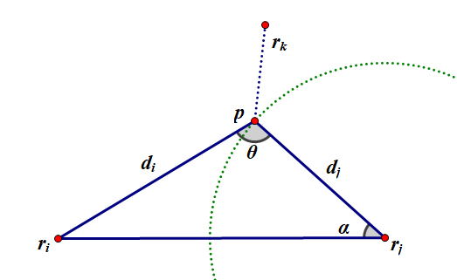
Anchor-Point Scheme: 2D Geometric Guarantee
In 2D case:
For non-marginal point p, we proved that 3 anchor points must exist within O(ε) distance with “good” positions for recovering p. (by covering of a circle)
Notes:
For the 2D case, we have proven that for non-marginal points, there must be 3 anchor points in a bounded neighborhood with positions good enough to stably recover the point with local edges, that is to say, one theta is not too close to zero or pi, so its position is not sensitive to perturbation of distances or positions of anchors. Since the structure of anchor points are stable, other non-marginal points can also be reconstructed with geometrical stability.

Slide 16
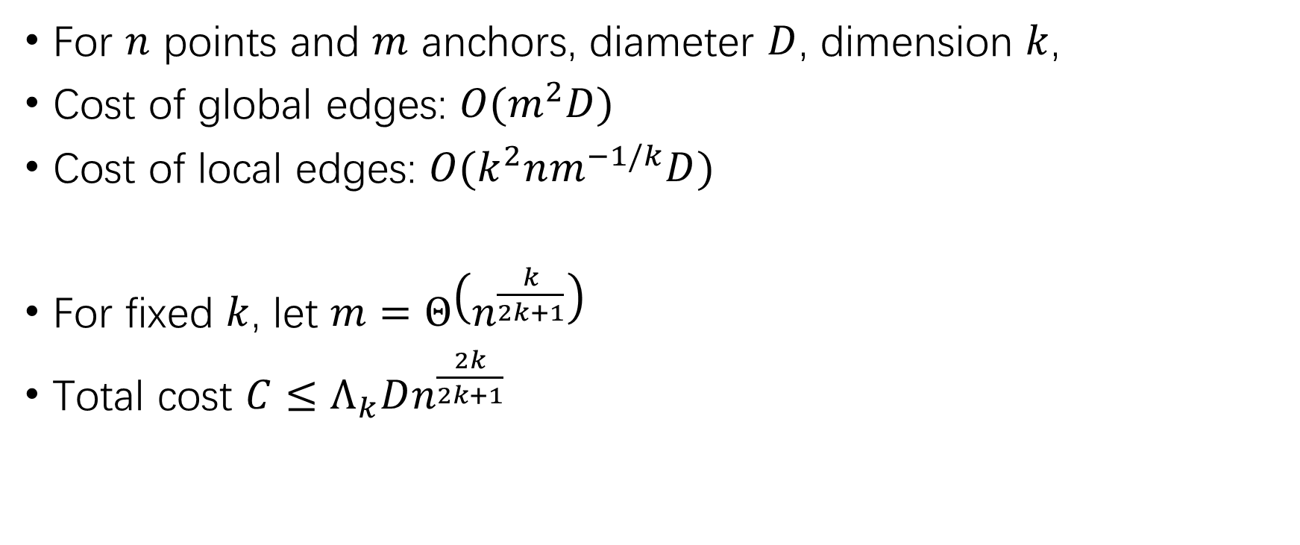
Cost Minimization
For $n$ points and $m$ anchors, diameter $D$, dimension $k$,
Cost of global edges: $O(m^{2}D)$
Cost of local edges: $O(k^{2}nm^{−1/k}D)$
For fixed $k$, let $m=Θ\left(n^{\frac{k}{2k+1}}\right)$
Total cost $C≤Λ_{k}Dn^{\frac{2k}{2k+1}}$
Notes:
Next we consider the optimal number m of anchor points. Whenever m is less than sqroot n, the increase in edge number is small. For the total edge length, larger m makes local edges shorter, but increases the number of expensive global ones. By the bound on epsilon, we can derive that the optimal m is about n to the k over 2k+1, and the total cost is in the power of 2k over 2k+1, sublinear to n.

Slide 17
Comparison (2D)
Complete graph: O(n²) global edges
Erdos-Renyi graph: O(n log n) global edges
Erdos-Renyi, weak: O(n) global edges
Anchor-Point scheme: O(n^{4/5}) global edges, O(n) local edges Low cost, easy MDS, geometrical stability guaranteed.
Application: motion capture, sensor network localization, etc
Notes:
Although not sure if it’s optimal, we did make the edge number and length a lot smaller than complete linkage, also smaller than random graphs. Besides, for our design we have a direct MDS algorithm for localization which is more efficient than optimization. This design can also be useful for motion capture, sensor localization and so on.

Slide 18
Acknowledgements
~(^_^)~
Notes:
In the end, I’d like to express my appreciation to Congyue Deng for inspiring my interest in graphics and encouraging me to keep up with initial dreams through my hard times. Best wishes for you.

Slide 19
THANKS!
Notes:
Thanks for listening. Is there any questions?

